Slide 1
PRELIMINARY DECLARATION OF DISCLOSURE
01
FL-140
02
FL-150
03
FL-142 or FL-160
04
Most recent two years tax returns

Slide 2
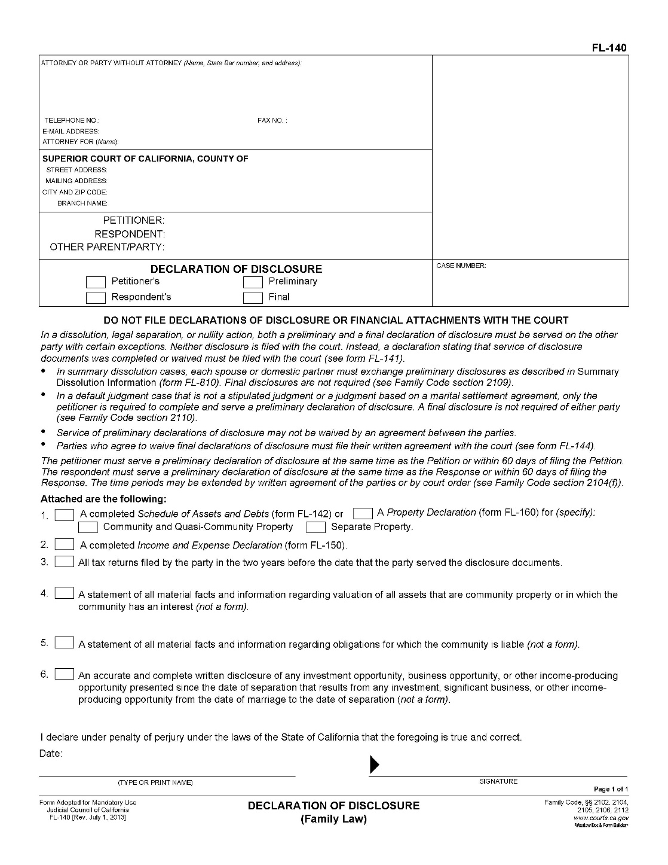
FL-140
Declaration of Disclosure
Law Offices of Lynda Sheridan
1801 Century Park E. Suite 1100 Los Angeles, CA 90067
Phone:
310-272-5357
Fax:
310-286-7292

Slide 3
FL-140
is your cover page and is signed under penalty of perjury as to the accuracy of your disclosures
Check the appropriate boxes
I prefer to use FL-142 over FL-160 due to comprehensive nature of FL-142
Law Offices of Lynda Sheridan
1801 Century Park E. Suite 1100 Los Angeles, CA 90067
Phone:
310-272-5357
Fax:
310-286-7292

Slide 4
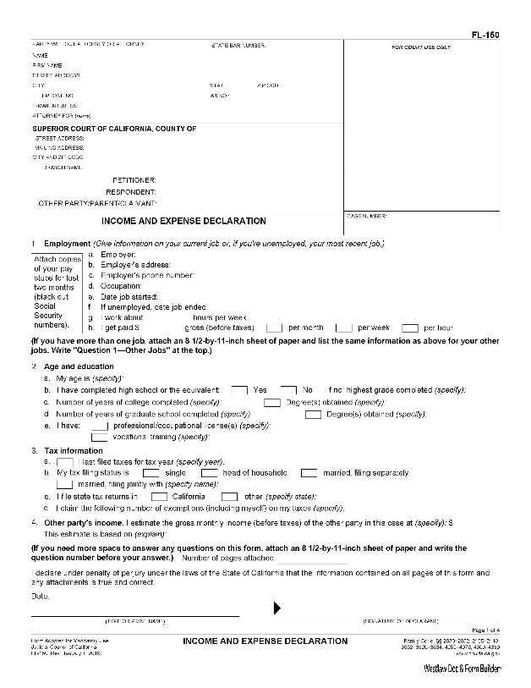
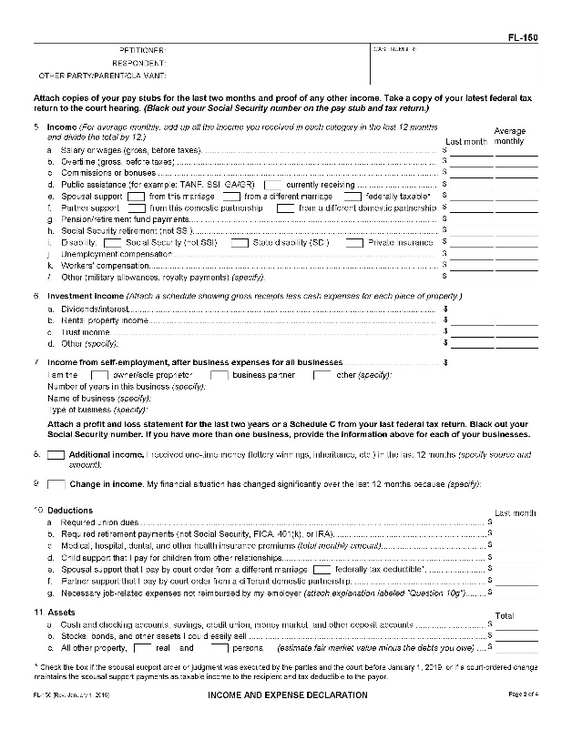
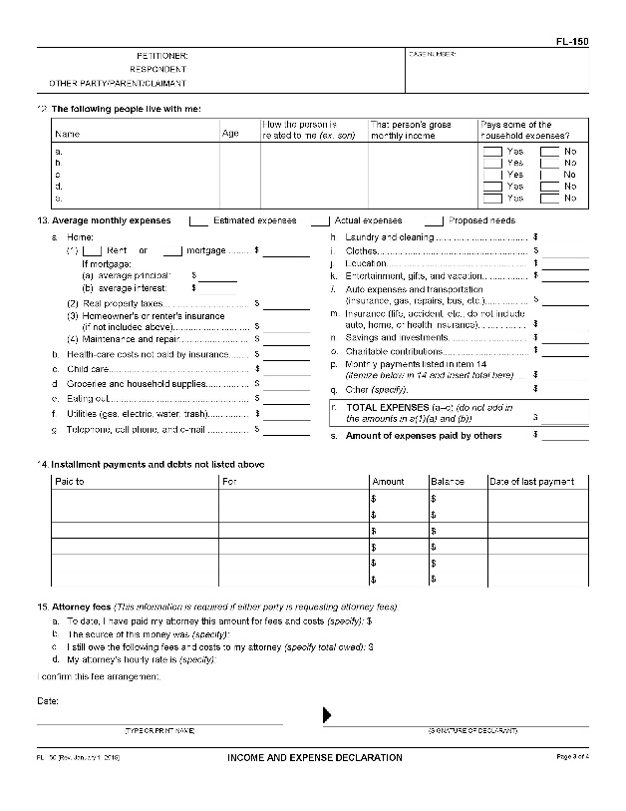
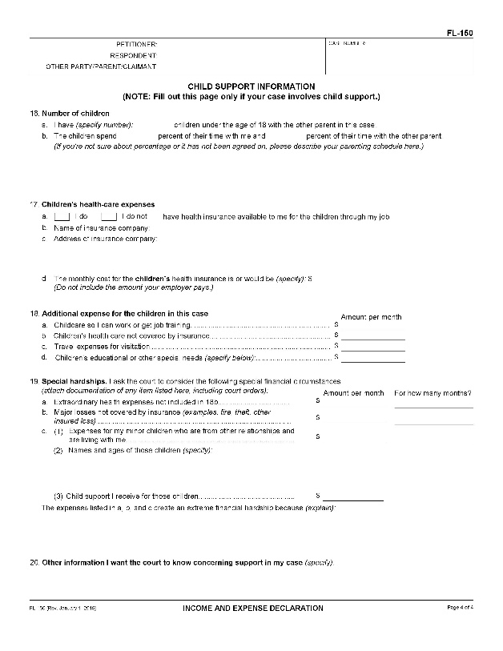
You MUST attached your PROOF OF INCOME,
e.g., 2 months paycheck stubs or if self employed a recent 12 month PnL
Page 1:
Complete ALL information
Page 2:
Insert your income information, leaving no blanks. If N/A insert 0.00 rather than N/A In the left column, insert the immediate last months earnings. In the right column, average your last12 months income.
[total and divide by 12]
Page 3:
Estimate you average 12 months expenses
Page 4:
Include the requested information if you have minor children
FL-150
Law Offices of Lynda Sheridan
1801 Century Park E. Suite 1100 Los Angeles, CA 90067
Phone:
310-272-5357
Fax:
310-286-7292

Slide 5
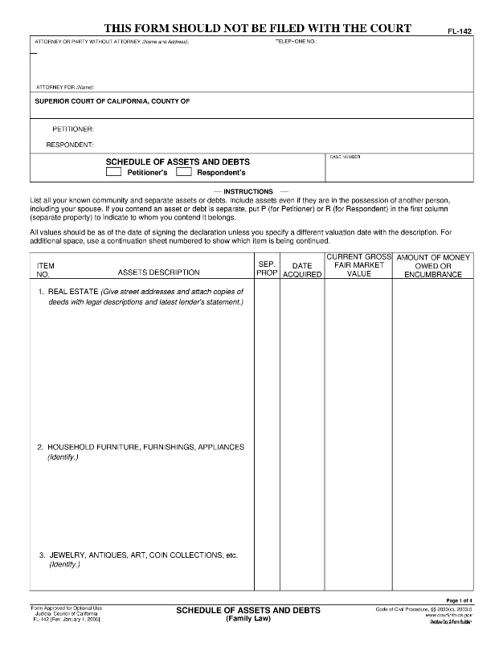
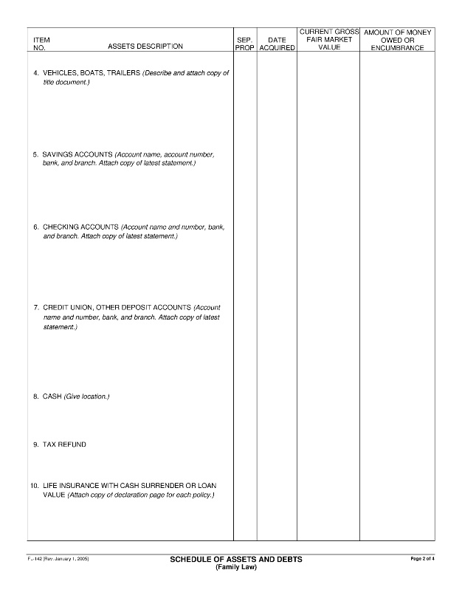
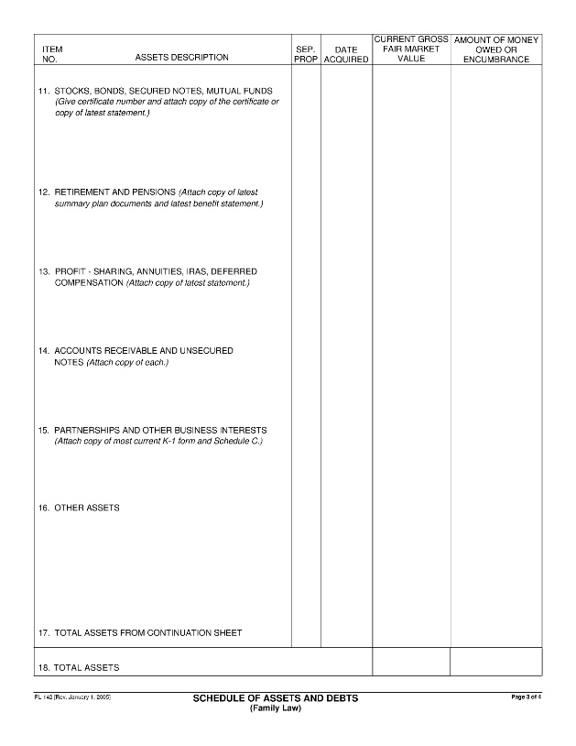
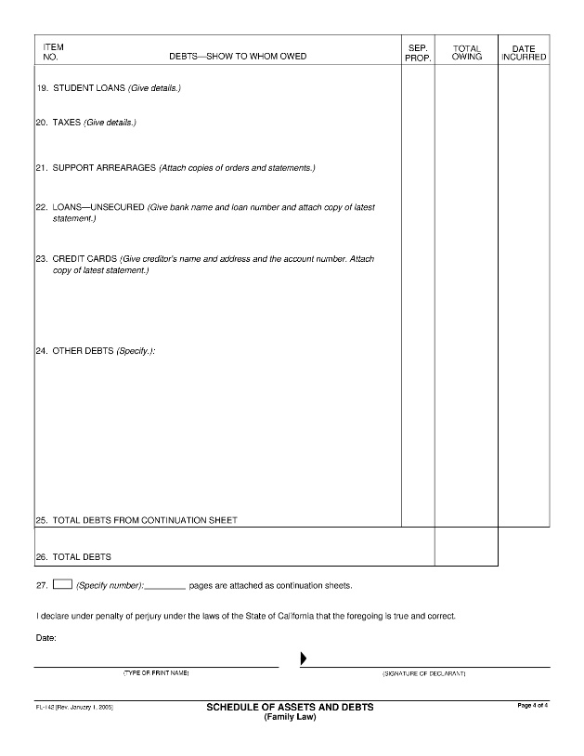
Four (4) Pages to list assets and debts
Insert applicable information OR NONE at each of sections 1-16 for assets and 19-24 for debts
For your Preliminary values are not required Fam. Code sec. 2104
If you contend an item is your separate property (meaning not acquired during the marriage or acquired by gift, etc. Fam. Code sec. 770), then place your party status (P or R) in the column next to the item
There are complicated issues of characterization to know so consult with an attorney regarding your claims to property
FL-142
Law Offices of Lynda Sheridan
1801 Century Park E. Suite 1100 Los Angeles, CA 90067
Phone:
310-272-5357
Fax:
310-286-7292

